Slide 1
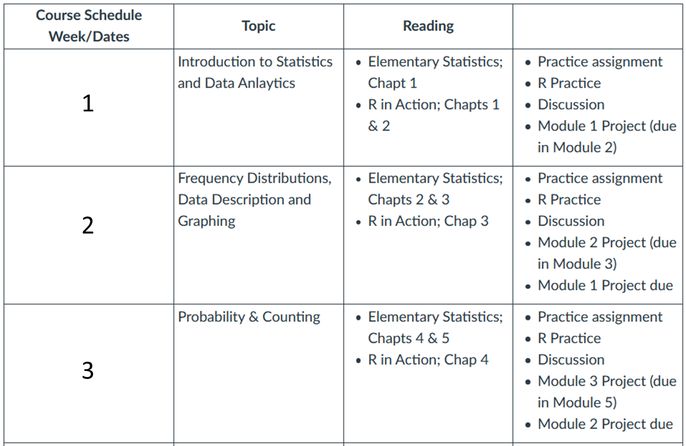
AYL6000 Introduction to Data Analytics

Slide 2

Probability Theory Fundamentals

Slide 3
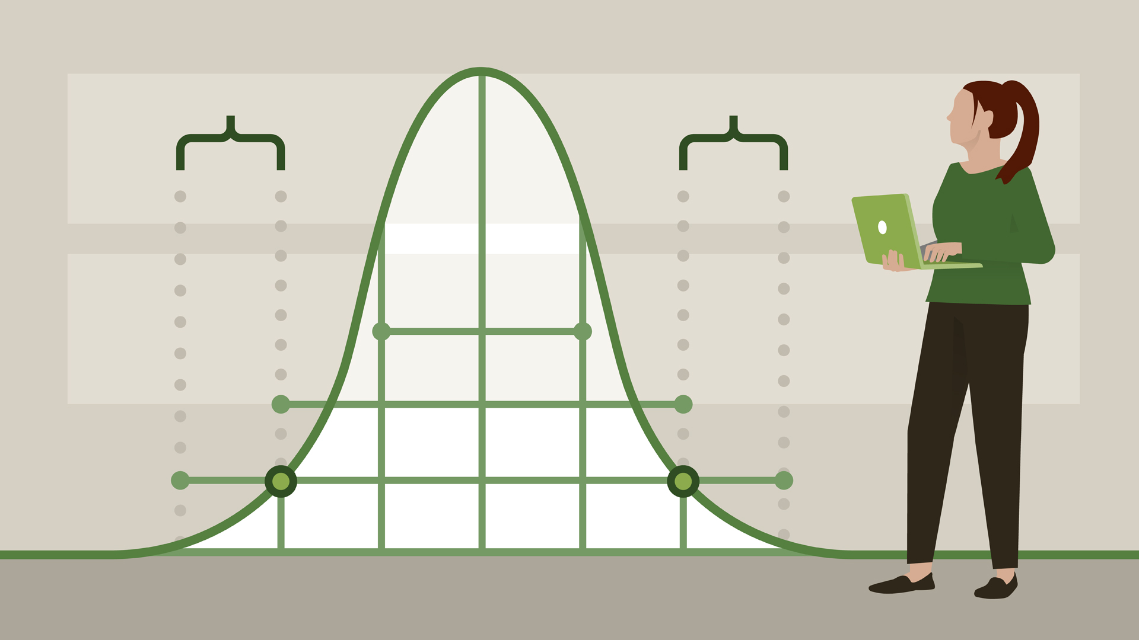

Slide 4
Data scientists need to be familiar with probability to answer business or scientific questions, which may influence strategic decisions managers make.
It allows a more accurate assessment of risk: which choices are safe and which choices are risky.
Probability is the chance of an event occurring.

Slide 5

Tail
Outcome / Single event
Sample space: collection of events.
Collection of all possible outcomes of an experiment.
S = {T , H}
How many options there are to mix these events?
S = {TT , TH , HT , HH}
Probability is a number between 0 and 1, why?
Head

Slide 6
A coin has two sides, the if we toss it once, how many observation we can make? How can you describe the sample space?
S = {T , H} and the possibility of each outcome is 1 out of 2, or 50%
What is the sample space of all observations if we toss it twice?
S = {TT , TH , HT , HH} and the possibility of each outcome is 1 out of 4, or 25%
What about if we toss it three times? How many different outcomes can we obtain? What will be the probability of each outcome?

Slide 7

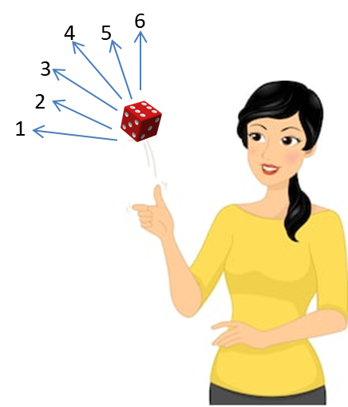
A die has 6 sides, if we toss it once we will obtain one number out of six, each with a probability of 1/6 or 16.7%
The sum of all events is always 1.0.
What is the probability of obtaining a number 4 P(4)?

Slide 8
Can you picture the sample space for rolling two dice?
S₂ = { 1,2,3,4,5,6}
S₁ = { 1,2,3,4,5,6}

Slide 9
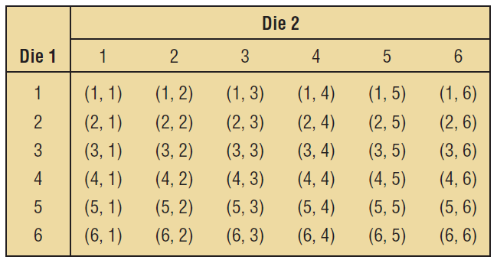
Can you picture the sample space for rolling two dice?
S₂ = { 1,2,3,4,5,6}
S₁ = { 1,2,3,4,5,6}

Slide 10

The nature of the sample space will depend: Does the order of the dice matters? Do you care for the actual numbers or their sums?
The order is important
The order is not important
The sum is important

Slide 11
Keep this example in mind when we talk about permutations and combinations.
The order is important
1,2 is not the same as 2,1
The order is not important
1,2 is the same as 2,1

Slide 12
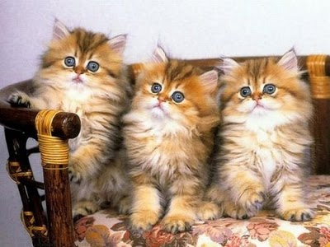
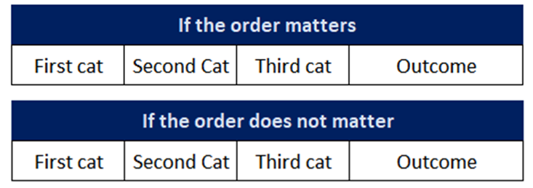
Can you picture the sample space for the following situation?
Your friend Betty adopted three cats. Each cat was adopted one month apart. Based on the cat sex (M or F), can you draw the sample space for all combination possibilities?
Write the sample space if the order matters.
Write the sample space if the order does not matter.

Slide 13
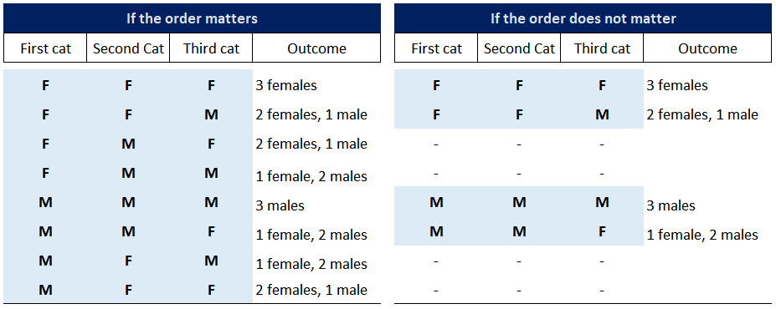

Slide 14

Complements, Unions, Intersections, and Basic Rules

Slide 15
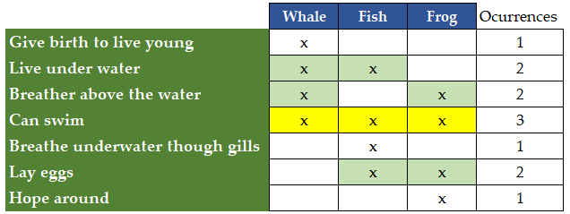
Complements, Unions, Intersections, and Basic Rules
We use Venn Diagrams to visually describe and understand the sample space of our experiments and the relationships between all our sets. For example, how do you describe the similarities and dissimilarities among whales, fish and frogs?
Is there a better way?

Slide 16
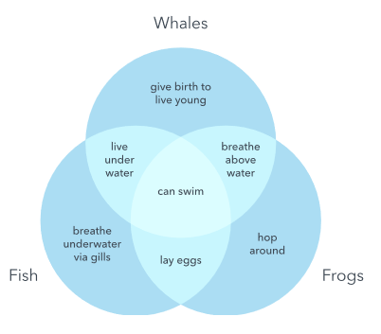
Venn Diagram

Slide 17
A Venn diagram contains all the sample space of the experiment.
If the probability that an event happen is 0.25, then the probability that it does not happen is 0.75.
P(it happens)
= 0.25
P(it does not happen)
= 0.75
S = 1.0
All the sample space is 0.25+0.75 = 1.0

Slide 18
Rules of Probability
The Complementary Rule of Probability: The sum of the probabilities of complementary events equals 1.
A
B
P(A) + P(B) = 1

Slide 19


Rules of Probability
The Addition Rule of Probability: Used when we need to find the probability of two or more events.
Two events are mutually exclusive when they cannot occur at the same time. The probability of their union equals the sum of their respective probabilities:
Two events are NOT mutually exclusive when they can occur at the same time. To find their probability, we need t sum heir individual probabilities and subtract their interception..
A
B
A
B
P(A and B) = 0

Slide 20
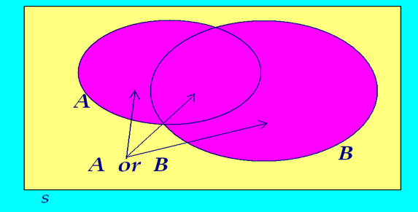
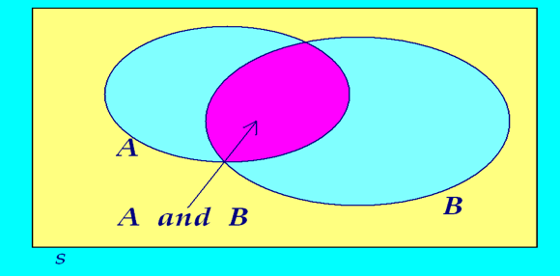
Sometimes, unions and interceptions are observed
(AUB) Union
(A∩B) Interception
The union of two events A and B, is the event that occurs if either A or B or both occur in a single performance of the experiment.
P(A or B)
The intersection of two events A and B is the event that occurs if both A and B occur in a single performance of the experiment
P(A and B)

Slide 21
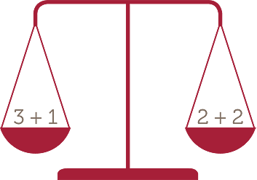
The addition rule of probability

Slide 22
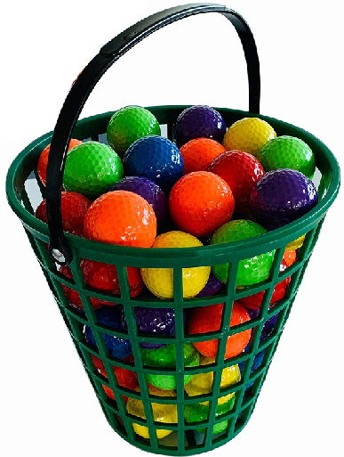
Two events are mutually exclusive events if they cannot occur at the same time
You have a bucket with color balls as follows:
Red 13
Blue 7
Yellow 11
Purple 9
Green 4
White 10
If one ball is chosen at random, what is the probability it is green or blue?
P(A or B) = P(A) + P(B)

Slide 23
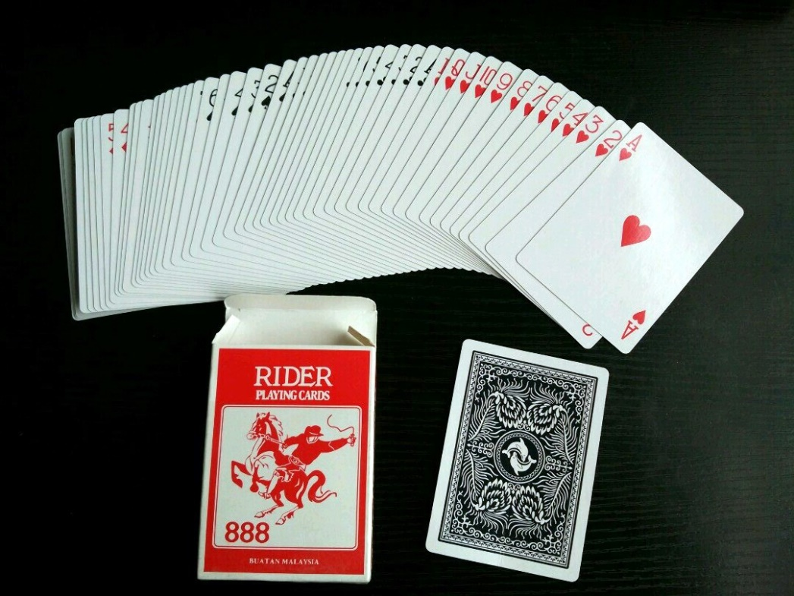


These events are NOT mutually exclusive
If you pick a card out of a deck, what is the probability that it is a 7 or a heart?
P(A or B) = P(A) + P(B) - P(A and B)
or
7H = 1
N = 4
N = 13
Notes:
4/52 + 13/52 – 1/52 = 16/52

Slide 24

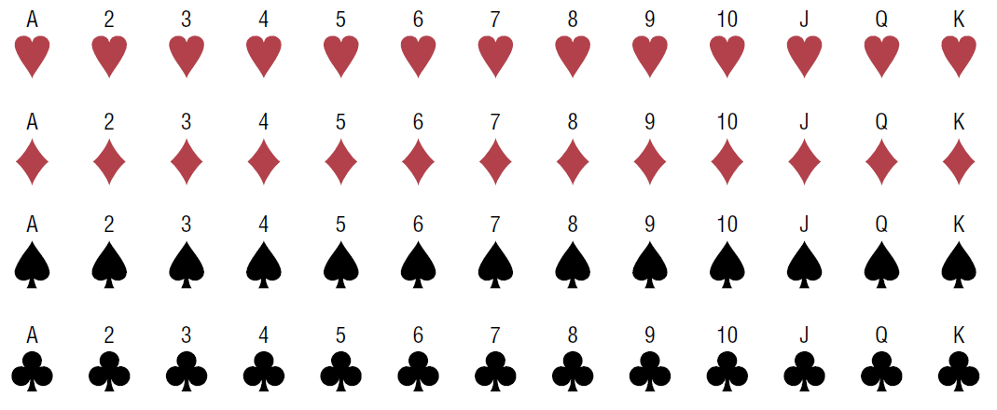
Sample space for drawing one card

Slide 25

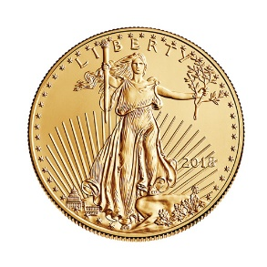

For the multiplication rule of probability, two sequential events are said to be independent when the occurrence of one do not influence the outcome of the second event.
It can be used to find the probability of two or more events that occur in sequence.
Select a card from a full deck, what is the probability it is a 7 and red?
Replace it and pick a card again, what is the probability it is again a 7 and red?
P(7R and 7R) = P(7R) * P(7R)
You flip a coin and a dice. What is the probability of obtaining a head and a 6?
P(H and 6) = P(H) * P(6)
Two events are independent events if the fact that A occurs does not affect the probability of B occurring.

Slide 26
Two sequential events are said to be dependent when the occurrence of one influences the outcome of the second event.
This is the conditional probability.
Select a card from a full deck, what is the probability it is a 7?
Do not replace the car, pick a card again, what is the probability it is a Queen?
P(A and B) = P(A) * P(B|A)
P(B|A) reads as: Probability of B occurring given than A has already occurred.
P(A and B) = P(A) * P(B|A)
P(A and B)
P(A)
P(B|A) =

Slide 27
Imagine that you conducted a survey among 2,600 people and ask their age and annual income, and you obtained the following data set:
Some immediate questions could be something like:
A. How many people were 25 years old or younger?

Slide 28
Imagine that you conducted a survey among 2,600 people and ask their age and annual income, and you obtained the following data set:
Some immediate questions could be something like:
A. How many people were 25 years old or younger? = 900
B. How many people make more than $50K per year?

Slide 29
Imagine that you conducted a survey among 2,600 people and ask their age and annual income, and you obtained the following data set:
Some immediate questions could be something like:
A. How many people were 25 years old or younger? = 900
B. How many people make more than $50K per year? = 1000

Slide 30
Imagine that you conducted a survey among 2,600 people and ask their age and annual income, and you obtained the following data set:
Some immediate questions could be something like:
A. People that were 25 years old or younger.
B. People that make more than $50K per year.
Calculate P(A) and P(B), the probability of those events happening (independent).
P(A) = 900/2,600 = 0.35
P(B) = 1000/2600 = 0.38

Slide 31
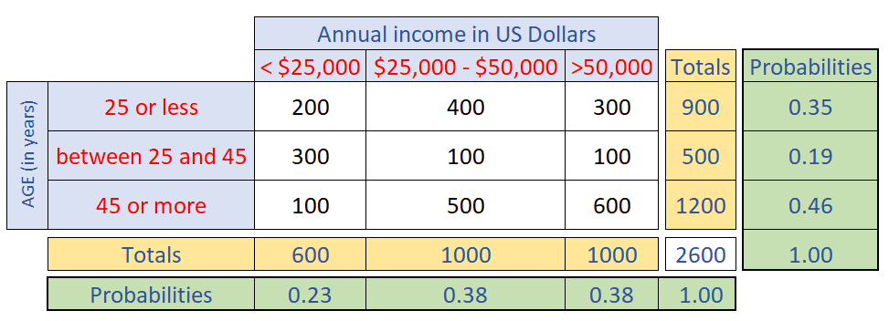
Consider the following events:
P(C) A person that is between 25 and 45 years old making less than $25,000
P(D) A person 45 years or older making more than $50,000

Slide 32
Consider the following events:
P(C) A person that is between 25 and 45 years old making less than $25,000
300/2,600 = 11.5%
P(D) A person 45 years or older making more than $50,000
600/2,600 = 23.1%

Slide 33
Consider the following events:
P(E) Of the age group 25 or less, what is the percentage making more than $50,000?
P(F) Of the age group 45 and more, what is the percentage making more than $50,000?

Slide 34
Consider the following events:
P(E) Of the age group 25 or less, what is the percentage making more than $50,000?
300/900 = 33.3%
P(F) Of the age group 45 and more, what is the percentage making more than $50,000? 600/1,200 = 50.0%

Slide 35

Probability trees

Slide 36
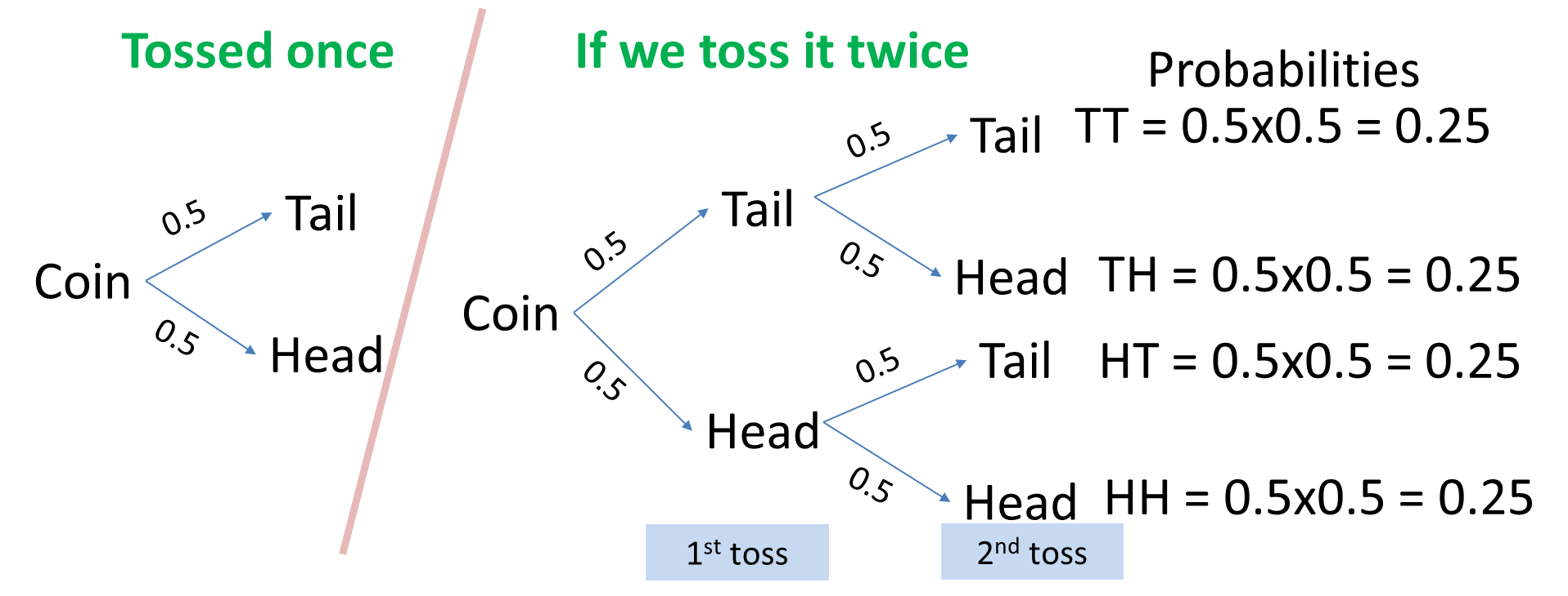
Probability trees or Tree diagram (to find total probability)
We use tree diagrams to graphically represent a probability space of a series of independent events or conditional probabilities. They help to make observations and calculations easier. Let’s go back to the example of the coin.

Slide 37

You go to restaurant with your friends and you found the following options:
First choice: Soda or Juice
Second choice: Bagel, rye or white bread.
Third choice: Cheese, pastrami, roast beef or turkey.
How many option there are in total?
Can you picture the probability tree?

Slide 38
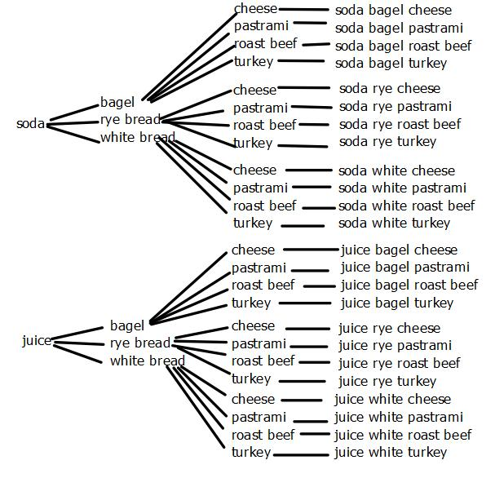
First choice: Soda or Juice
Second choice: Bagel, rye or white bread.
Third choice: Cheese, pastrami, roast beef or turkey.

Slide 39
Remember the example of the kittens?
Can you build a probability three to display the order of cat adoption depending on sex?
MMM MMF MFM FMM FFF FFM FMF MFF
First cat, male or female?
Second cat, male or female?
Third cat, male or female?

Slide 40

Third cat
Second cat
M
MMM
First cat
M
F
MMF
M
F
M
MFM
F
MFF
M
FMM
F
M
F
FMF
F
M
FFM
F
FFF

Slide 41
Reading topics:
Bayes' theorem
Simpson’s Paradox
Combinations and permutations

Slide 43

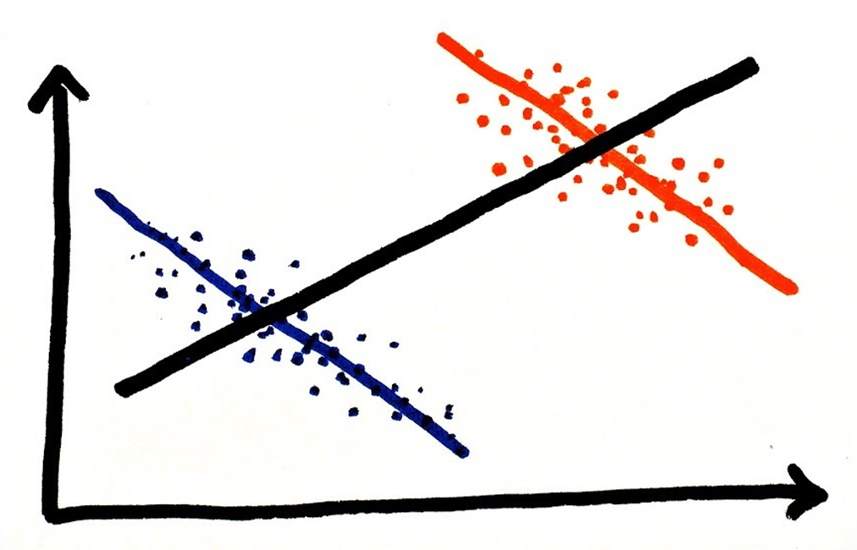
Bayes' theorem
Bayes' theorem describes the probability of an event, based on prior knowledge of conditions that might be related to the event. In other words, it allow us to find an unknown probability using other probabilities that we know.
Simpson’s Paradox
Occurs in probability and statistics when trends exist in different groups, but the tendency disappears or changes when these groups are combined. It is a reminder of how easy it is to fall into paradoxical conclusions when relying solely on intuition.

Slide 44

Combinations and permutations
Sometimes the order of events matters, other times it doesn’t. Combinations are defined when the order doesn’t matter, permutations when the order matters. E.g., (combination) what are the ingredients of a chicken soup? (permutation) What is the order to add ingredients to make the soup?
In other words, a permutation is an ordered combination.

Slide 45

The permutation Principal
Type (i): An ordered arrangement of n distinct objects
In how many different ways can 5 books be placed in a bookshelf?
5 ! = 5 x 4 x 3 x 2 x 1 = 120
Type (ii): Permutation of n elements taken r at a time
In how many different ways can we choose a committee of 3 people from a group of 10 people such that one of them becomes the president, the other becomes the vice president, and the third becomes a financial officer

Slide 46

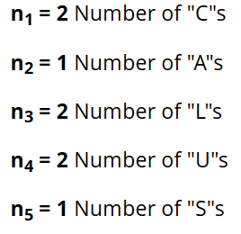

The permutation Principal
Type (iii): Distinguishable permutation of n elements
The number of distinguishable permutations of n elements where n₁ are of one kind, n₂ are of another kind, and so on.
In how many ways can the letters in the word “CALCULUS” be arranged?

Slide 47
